Slide 1
Using Line to Create Form and Value
Design

Slide 2
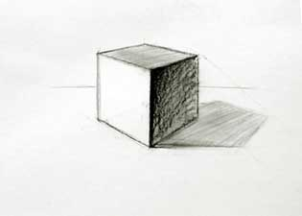

What is Form?
Form happens when you add value, height and depth to a 2-D shape.

Slide 3
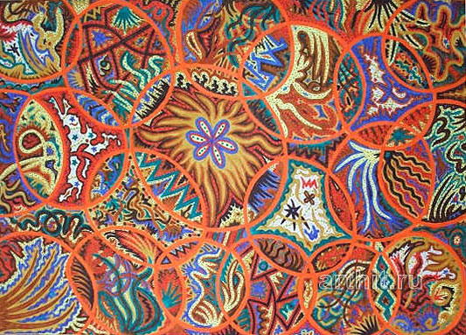
What is Unity?
Unity is seen in a painting or drawing when all the parts equal a whole. Your
work should
not appear
disjointed or
confusing.

Slide 4
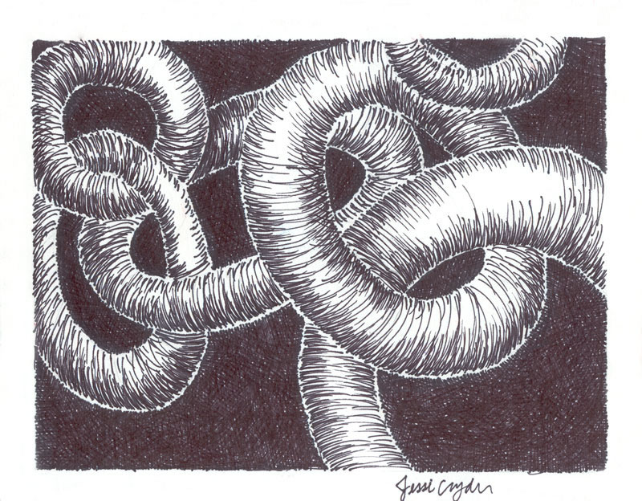
schools.lwsd.org/LWHS/users/staff/wyatt/Beg_Drawing/Student%20Gallery/Curved_line_gallery/Fall_05/index.htm

Slide 5
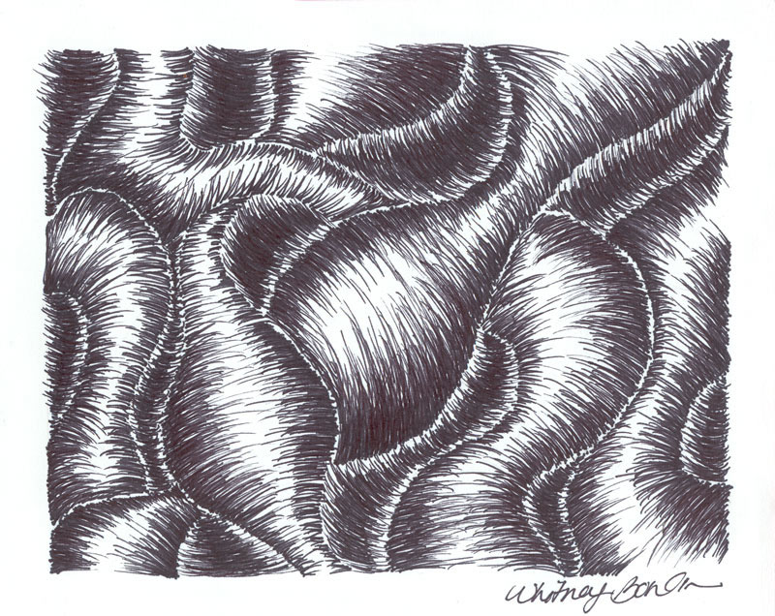
schools.lwsd.org/LWHS/users/staff/wyatt/Beg_Drawing/Student%20Gallery/Curved_line_gallery/Fall_05/index.htm

Slide 6
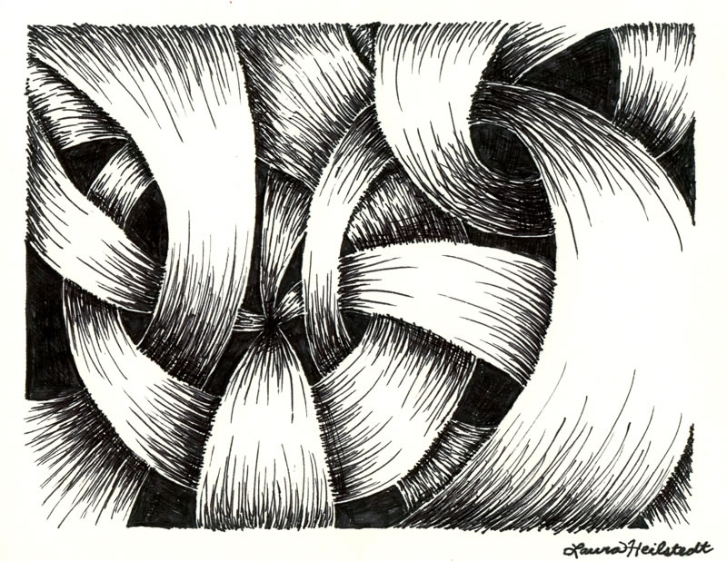
`
schools.lwsd.org/LWHS/users/staff/wyatt/Beg_Drawing/Student%20Gallery/Curved_line_gallery/Fall_05/index.htm

Slide 7
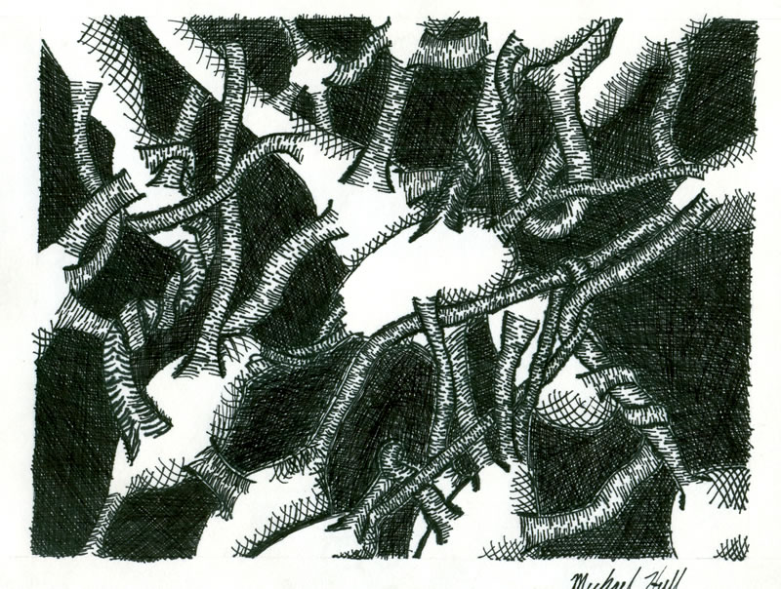
schools.lwsd.org/LWHS/users/staff/wyatt/Beg_Drawing/Student%20Gallery/Curved_line_gallery/Fall_05/index.htm

Slide 8
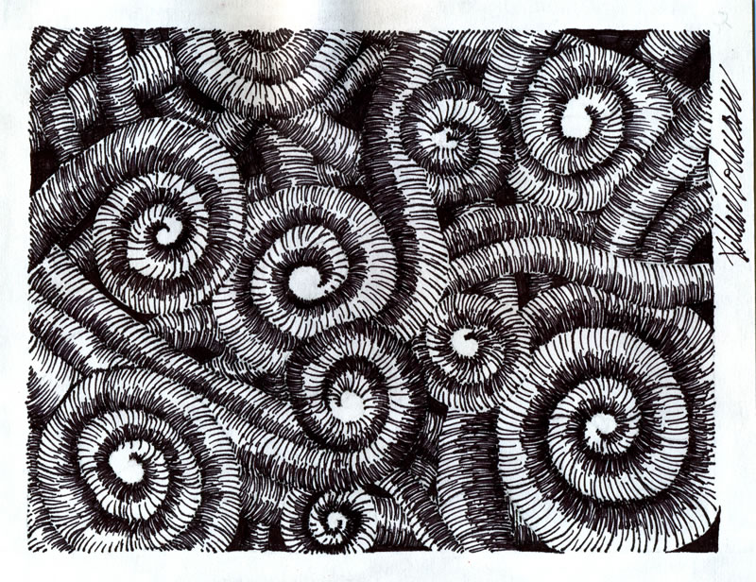
schools.lwsd.org/LWHS/users/staff/wyatt/Beg_Drawing/Student%20Gallery/Curved_line_gallery/Fall_05/index.htm

Slide 9
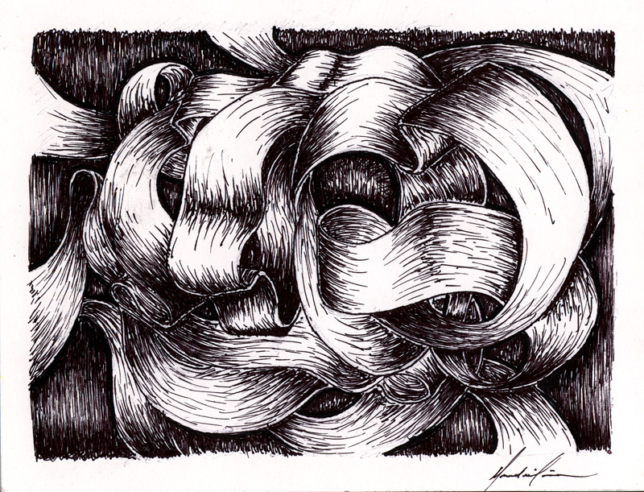
schools.lwsd.org/LWHS/users/staff/wyatt/Beg_Drawing/Student%20Gallery/Curved_line_gallery/Fall_05/index.htm

